Slide 1
Ericsson 2015 hackathon

Slide 2
ALMCOnnect
Team Ronin
Members
Ahmed Abouzeid
Maziar Mohammad-Shahi
David Sciacchettano
Reza Farhadi

Slide 3
ALMConnect - Purpose
What’s It For?
Staying connected to OpenALM in a less obtrusive manner
Avoid polluting the Outlook inbox
Display more specific and user-friendly information

Slide 4
ALMConnect - Goals
Our Objectives
Create a RESTful API between a client and server
Create a Chrome extension that provides OpenALM updates on artifacts that a user is following in real time.
Provide pop-up notifications in the extension in Chrome when OpenALM is updated
Dynamically follow OpenALM artifacts by id.
Technologies
Django Framework, Python, JavaScript, JSON, HTML, CSS, RESTful Web Services

Slide 5
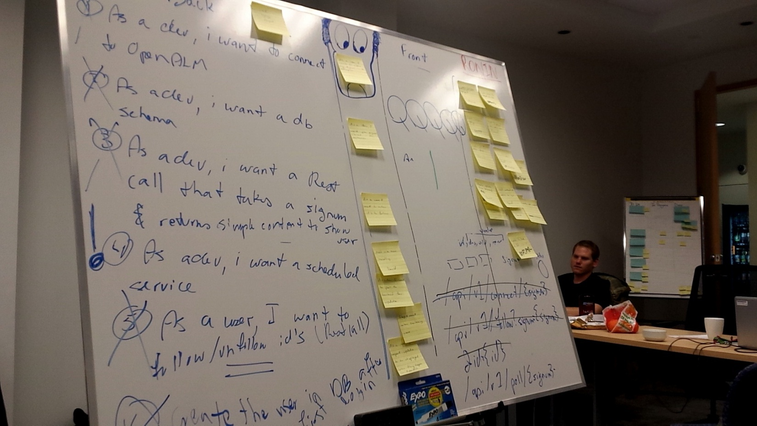
Almconnect - methodology
Agile Methodology

Slide 6




Workflow
ALM
Connect
Follow
Poll
Get Token
Get Artifact Details

Slide 7
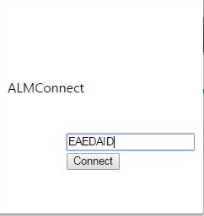
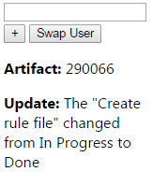

Almconnect - demo

Slide 8
Almconnect - results
Goals achieved
Users tracked
Artifacts linked to users tracked
OpenALM updates detected
Updated details displayed in extension
Follow artifacts works properly

Slide 9
Almconnect - retrospective
Incredible experience
Opportunity to try completely different technologies
Great teamwork
New learning experience
Chrome extension not well documented & tricky to develop for

Slide 10
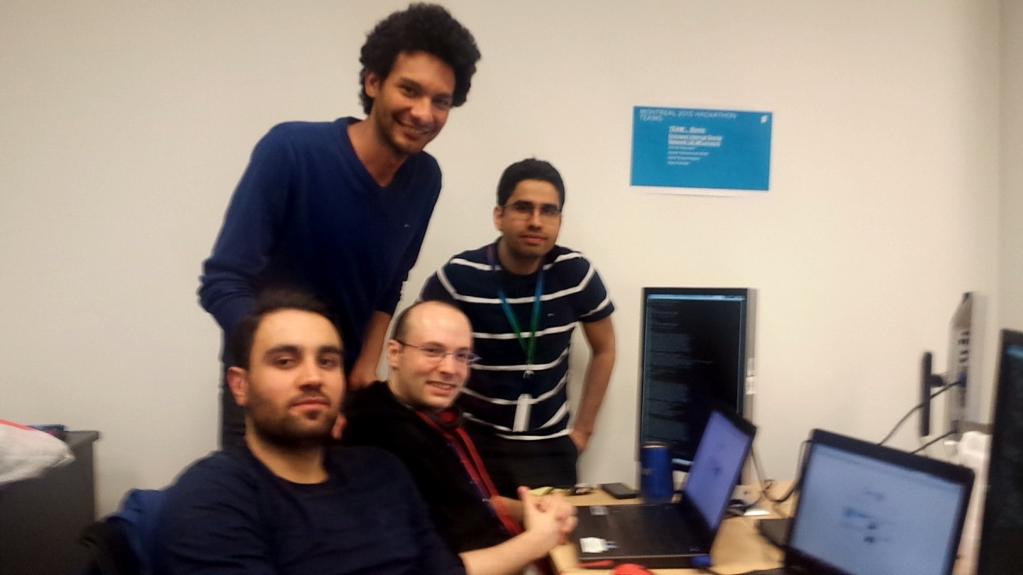
Almconnect
Team Ronin

